Slide 1

Addressing the Skills Gap Among Students
The lack of essential skills among students is a growing concern that significantly impacts their employability and capacity to succeed in a competitive job market. This issue underscores the urgent need for educators and policymakers to collaborate and develop effective strategies to equip students with the necessary skills to thrive in their future careers.

Slide 2
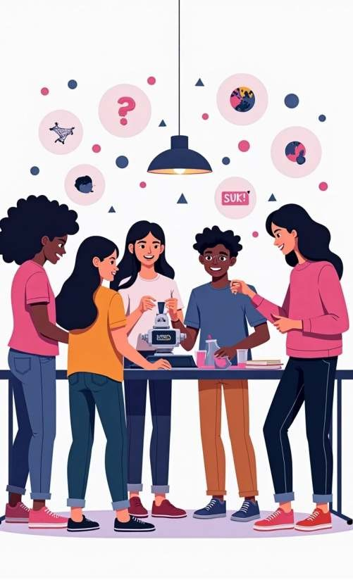
Root Causes of Skills Gap
Education System Limitations
Traditional education often emphasizes rote learning over critical thinking.
Technology Overreliance
Excessive use of technology can diminish hands-on skills and critical thinking.
Curriculum Misalignment
School curricula often do not meet modern job market needs.

Slide 3
Essential Skills Deficiency
Communication Skills
Critical Thinking
Many students struggle with effective written and verbal communication, which is critical for collaboration and
professionalism in the workplace.
The ability to analyze information and make decisions is often
underdeveloped. Students may find it challenging to evaluate situations and propose viable solutions.
Emotional Intelligence
Technical Proficiency
Soft skills like empathy and emotional
regulation are crucial for workplace
success, yet they are frequently overlooked in favor of technical skills.
As industries evolve, students need to be tech-savvy. A lack of understanding of relevant software and tools can
render graduates less competitive.

Slide 4

Impact on Employment
Increased Unemployment Rates
Economic Consequences
Job Satisfaction Issues
A workforce unprepared for various roles leads to productivity losses
and impacts overall economic
growth. Companies may struggle to find qualified employees, stalling
innovative progress.
Employees who feel inadequately prepared may experience lower job
satisfaction, leading to higher
turnover rates and potential
negative impacts on company culture and morale.
A skills gap contributes to rising unemployment numbers among
recent graduates. Employers often find candidates lacking in basic
competencies required for entry- level positions.

Slide 5
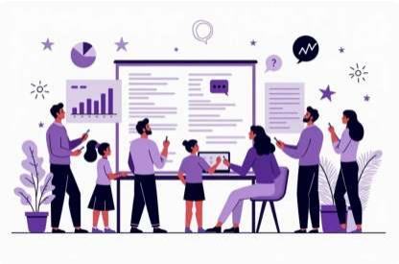
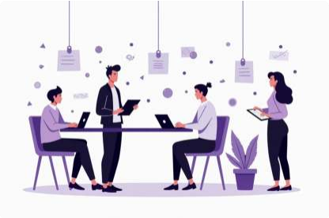
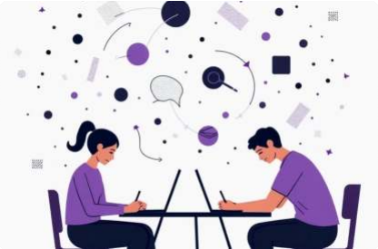
Solutions and Recommendations
Curriculum Reform
Workplace Collaborations
Skill Assessment Programs
Educational institutions need to update curricula to include critical thinking,
problem-solving, and communication skills as core components of learning.
Partnerships between schools and local businesses can provide students with
real-life experiences. Internships and mentorships can bridge the gap
between theory and practice.
Regular assessments to identify skill
deficiencies can help tailor educational approaches and provide targeted
support to students who need it most.

Slide 6

Role of Educators
Professional Development
Teachers must receive ongoing training to stay updated on the
latest best practices and industry demands.
Innovative Teaching
Methods
Educators should adopt project-based learning and
interactive teaching methods to foster critical skills.
Focus on Collaboration
Encouraging team-based projects can improve students'
interpersonal skills.

Slide 7
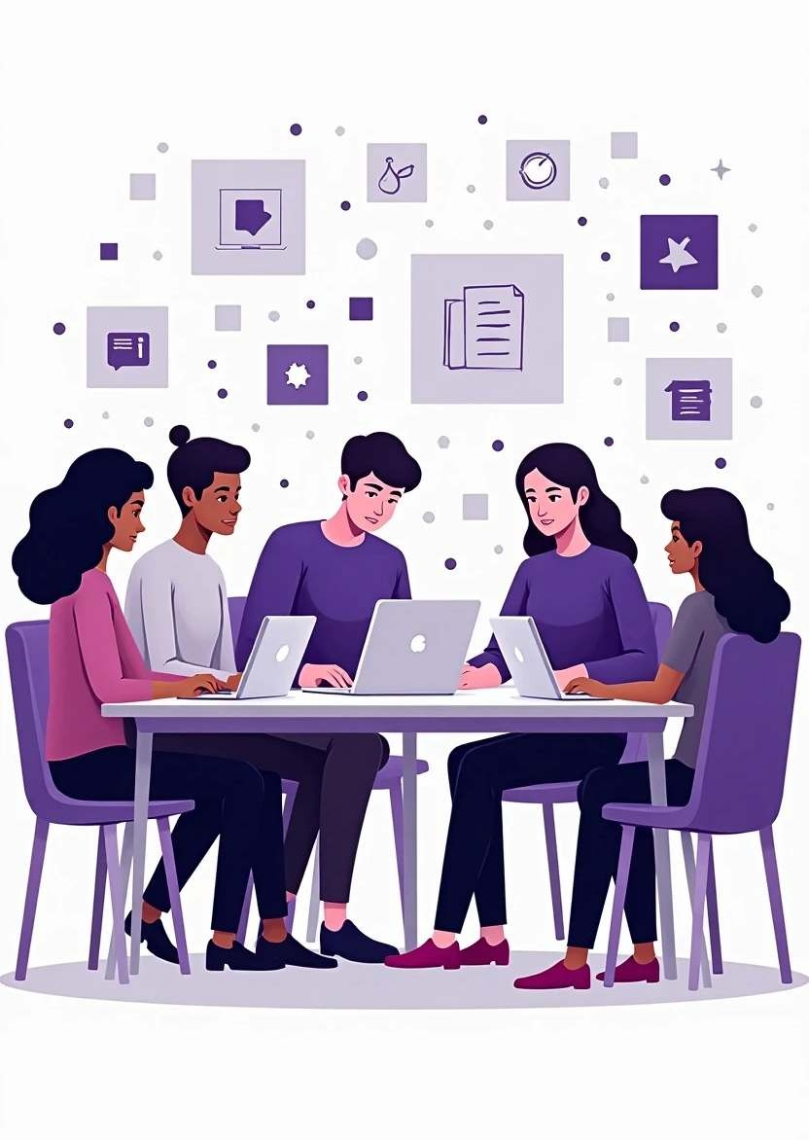
Success Stories
Tech Bootcamps
Many tech bootcamps have successfully equipped students with necessary skills rapidly.
University Initiatives
Some universities have revamped their programs incorporating essential skills training.
Community Programs
Local community organizations focused on vocational training have empowered students.

Slide 8

Ensuring Student Success Through Skills Development
Urgent Attention Collaborative Approach Long-Term Impact Required
A collective effort from educators, businesses, and policymakers is essential to create a supportive
ecosystem.
Focusing on skill enhancement will cultivate capable individuals
contributing positively to society and the economy.
Addressing the lack of skills among students is crucial in ensuring their
future success and economic stability.

